Slide 1

Review Rating Prediction
Submitted by:
PAVANKUMAR BOLLI

Slide 2
ACKNOWLEDGMENT
I would like to express my special thanks to flip robo technologies for given me such a wonderful of opportunity to explore and InSite work on a data science projects.
And also thanks to Data trained institute’s mentors to motivate and understand the concepts of Data science. I have got lot of help from their resources and concept to complete these project.
Link that helps me to complete this project
https://scikit-learn.org/stable/modules/generated/sklearn.neighbors.KNeighborsClassifier.html
https://scikit-learn.org/stable/modules/generated/sklearn.tree.DecisionTreeClassifier.html
https://scikit-learn.org/stable/modules/generated/sklearn.linear_model.LogisticRegression.html
https://scikit-learn.org/stable/modules/generated/sklearn.svm.SVR.html
https://scikit-learn.org/stable/modules/generated/sklearn.pipeline.Pipeline.html

Slide 3
INTRODUCTION
Business Problem Framing
We have a client who has a website where people write different reviews for technical
products. Now they are adding a new feature to their website i.e. The reviewer will have to
add stars(rating) as well with the review. The rating is out 5 stars and it only has 5 options
available 1 star, 2 stars, 3 stars, 4 stars, 5 stars. Now they want to predict ratings for the
reviews which were written in the past and they don’t have a rating. So, we must build an
application which can predict the rating by seeing the review.
Conceptual Background of the Domain Problem
Data is gather from different different e-commerce web site’s. Data is scrap by using selenium. Selenium is one of best testing tool that I've used for to scrap data from the e-commerce website’s html page. Data have the three columns i.e. Rating Heading, Rating and Review. So I have a scrap a data from such as amazon and flip kart. I have scrap review and rating approx. 200 rows both positive and negative review and also I have handle to scrap close to equal number of ratings like 1 ,2,3,4,5 star from each products. Product like laptops, monitors', headphones, smart watches', mobiles, routers and home theatre's.

Slide 4
Motivation for the Problem Undertaken
Motivation of this project is to determine the rating form out of 5 star on the basis of review written by user. This also help’s to determine the product quality and type of review that is towards to positive or negative. On the basis of rating we can conclude the quality of product if product has much number of 5 star rating’s means product was awesome if average rating is 3 or 4 star means product has some positive and some negative which has to improve or rectifies those issues.

Slide 5
Analytical Problem Framing
Data Sources and their formats
In this project I've scrap almost 1 lack 14 thousand rows. So I have took a sample data up to 35 thousand rows and worked on it. This sample data can be inference to entire data. While scrapping the review some of rows got null values or got null values in rating column. I have drop those columns which has null or having string like “-”. Firstly I have created different different csv files for each product with respect to web sites. Created on data frame in which i have merged all the data sets and created one single data.
Data Pre-processing Done
In this project each data is in text format machine can understand only numbers. So for this I have used tool kit of NLP (Natural Language Processing) that is NLTK. In the part of data cleaning I have removed stop words, punctuation, emojis, numbers extra spaces, words length have less than 2, and removed email addresses etc. Because this type of data is not use full for the prediction rating this type of words are increasing the length of the text. After cleaning the data I have stem each words to give the base words and remove plural’s and tenses. For stemming the words i have used Lemmatization package which is in NLTK. After all these steps i have converted text to numbers by using TFIDF and Count Vectorizer

Slide 6
What were the steps followed for the cleaning of the data? What were the assumptions done and what were the next actions steps over that?
Data Inputs- Logic- Output Relationships
Review’s are in text format and in any certain language’s. Based on words present in the review rating get predicted. Suppose in review word’s like excellent great awesome this type of words represents product was really good and it will give a rating 4or 5 star. Same as negative words will give rating 1 or 2 star.
Hardware and Software Requirements and Tools Used
Tools and libraries that I have used to solve project:
Software: Anaconda, Jupyter Notebook, Python3, Google Collab.
Libraries: NumPy, Pandas, Matplotlib, Seaborn,Sklearn.

Slide 7
Model/s Development and Evaluation
Identification of possible problem-solving approaches (methods)
The data set contain label data and target data label has cleaned by some EDA steps. Target data is in the form of classified i.e. (Rating). By seeing the our target column we can conclude that this problem comes under supervised and Classification Problem. Target column having in factor . For more testing SVC, Decision Tress Classifier, KNN algorithms have used. Rather testing on one by one algorithm and choosing best algorithm and hyper tuning that best model. I have hyper tunned all the algorithm and added into pipeline so i will get best algorithm along with the best parameters.
Testing of Identified Approaches (Algorithms)
For testing how good model is generated. I have splitted data set into two parts (70% 30%) and each part is splited into further two part that are label data and target data. First 70% splited data is used for training the model and another rest of 30% used for Prediction testing the model how good model is predicted in terms of percentage.
Key Metrics for success in solving problem under consideration
What were the key metrics used along with justification for using it? You may also include statistical metrics used if any.

Slide 8
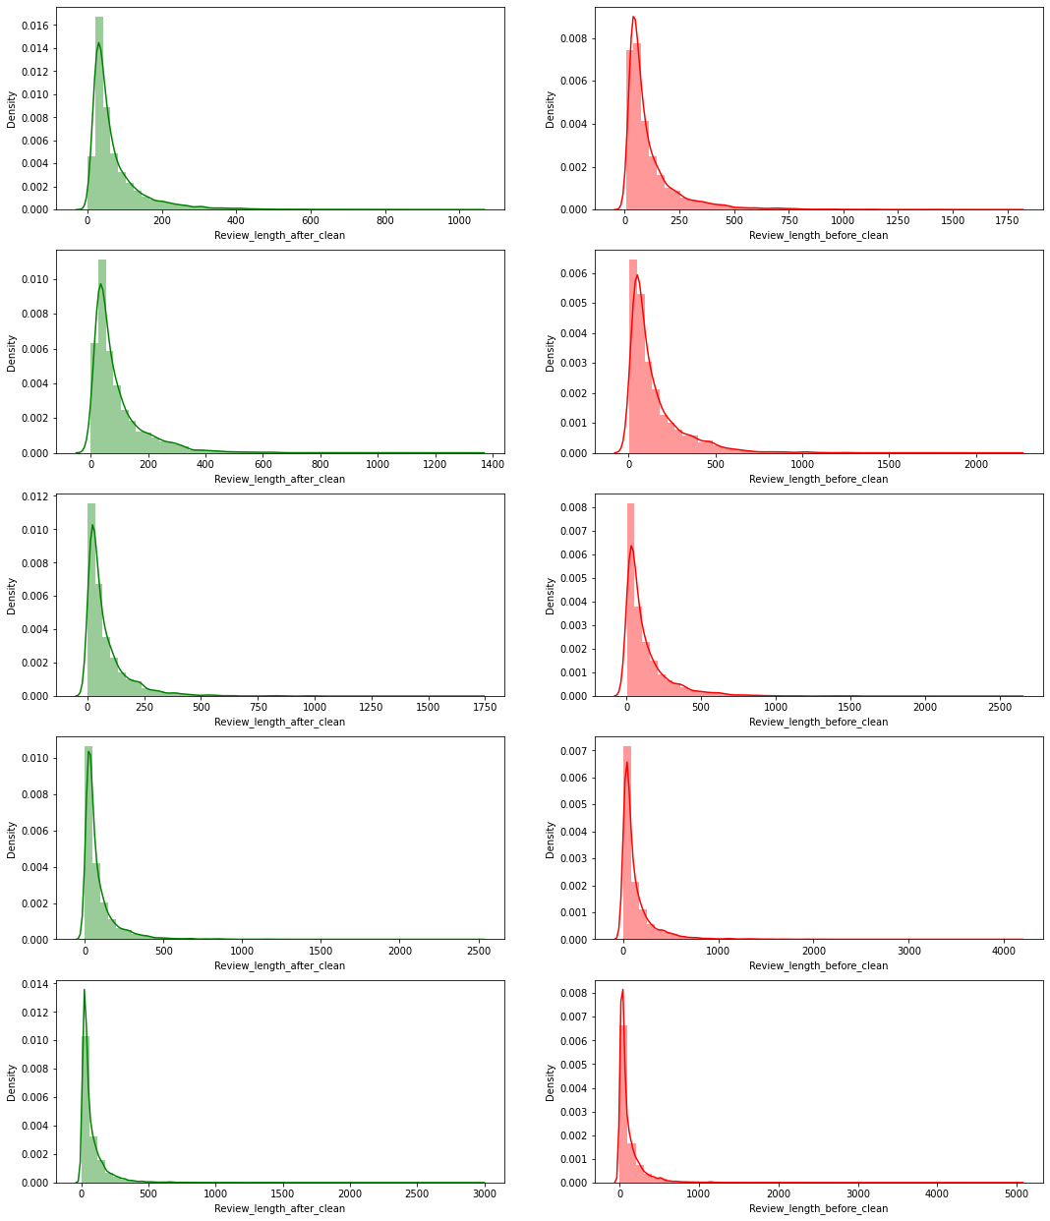
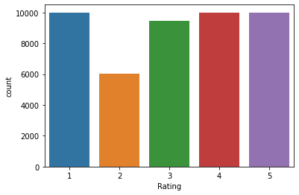
Visualizations

Slide 9
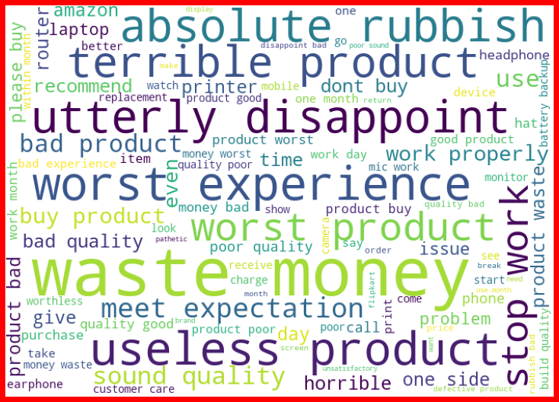

Slide 10
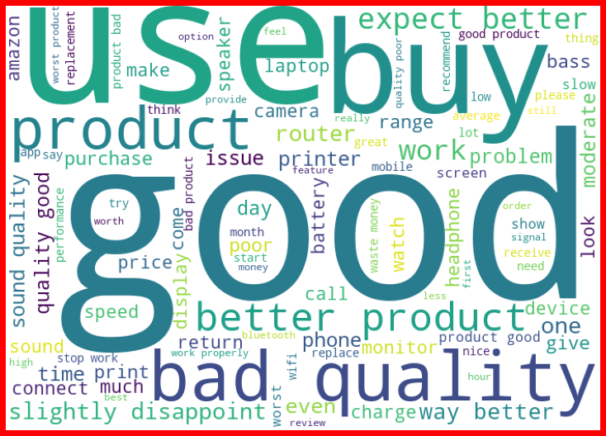

Slide 11
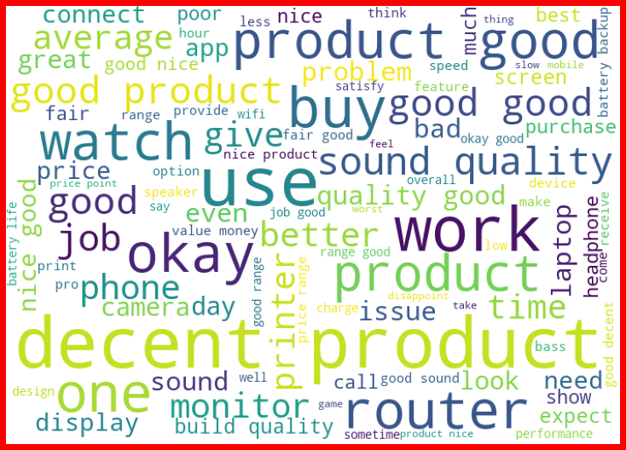

Slide 12
CONCLUSION
Learning Outcomes of the Study in respect of Data Science
I have learn some inbuild function of python at the time of data cleaning. Object columns to Integer are done by using python map function over on lambda function. The main challenging is that to run all model once and get the best model name with best parameters also with a AUC ROC curve plot. This is done by using pipeline. This will helps me to get out from overfitting and underfitting.

